Slide 1
COVID-19 Tracking Germany
https://www.kaggle.com/datasets/headsortails/covid19-tracking-germany

Slide 2
Background
Coronavirus disease (COVID-19) is an infectious disease caused by the SARS-CoV-2 virus.
The first known case was identified in China Wuhan at December 2019.
The disease quickly spread worldwide, resulting in the COVID-19 pandemic.
This dataset provides daily updated number of reported cases & deaths in Germany on state and county level from January 2020.
A dataset on vaccination progress from December 2020.
And a general state-level population demographics.

Slide 3
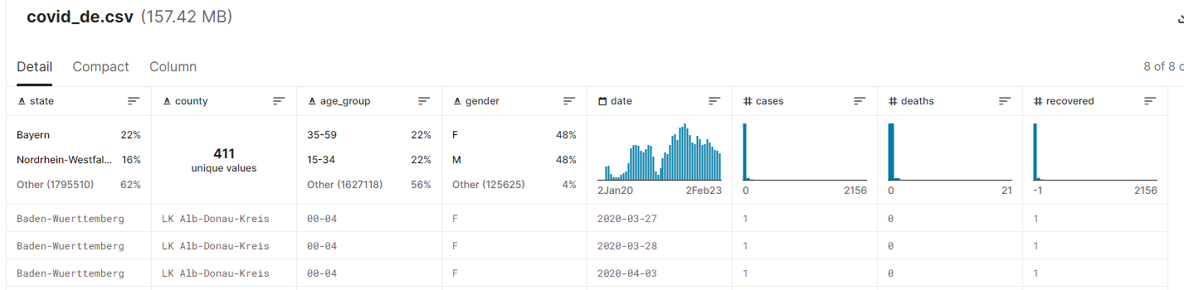
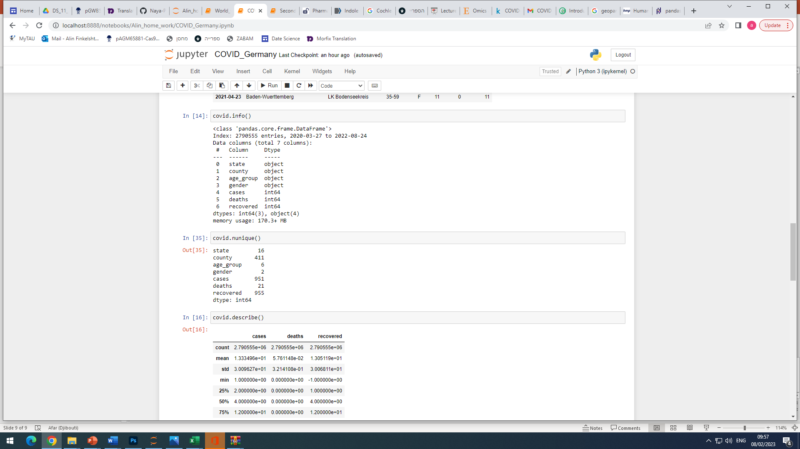
Dataset contains 3 tables:
covid_de.csv
Nunique
…………….

Slide 4
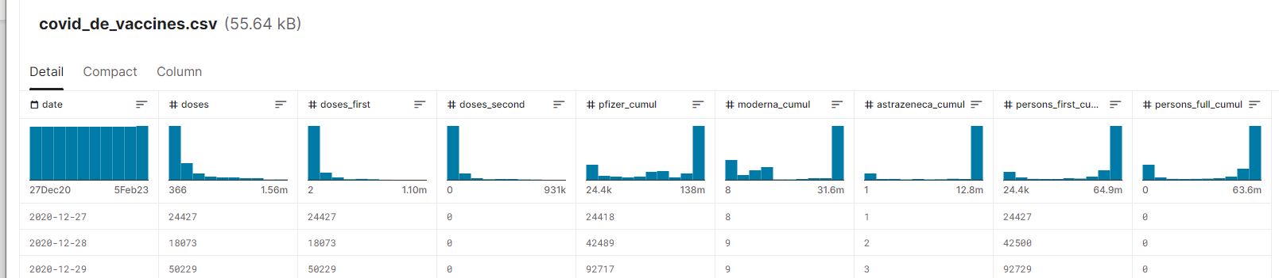
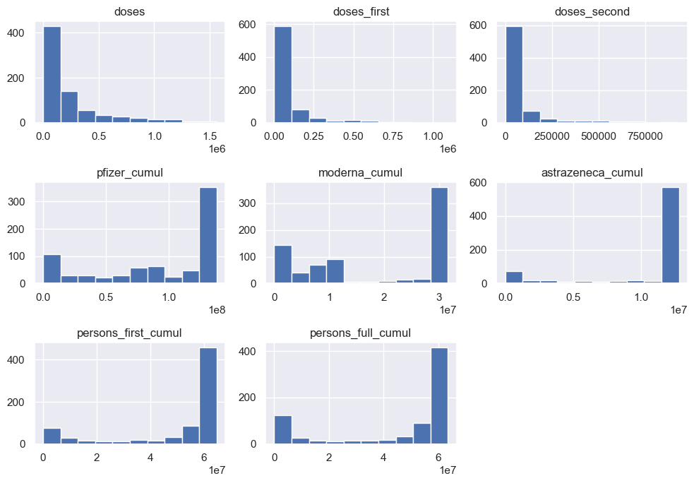
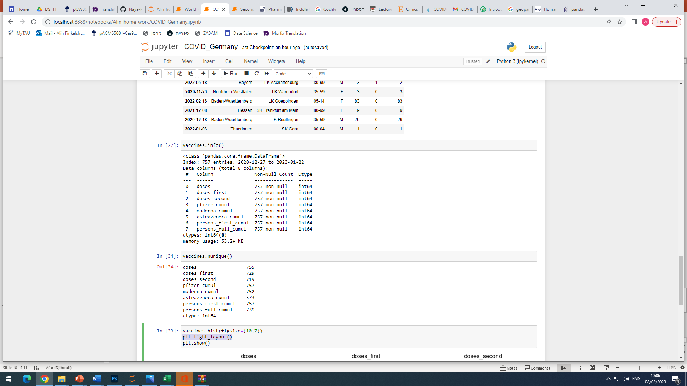
covid_de_vaccines.csv
Nunique
…………….

Slide 5
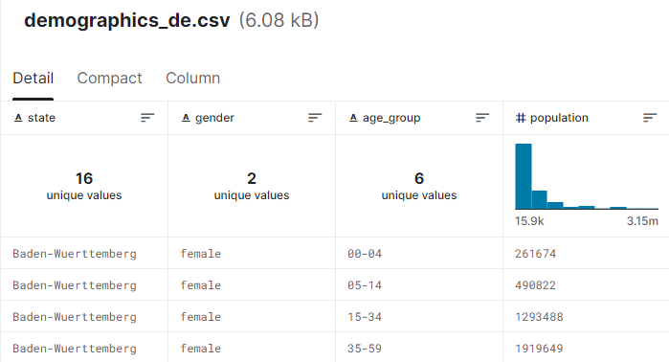
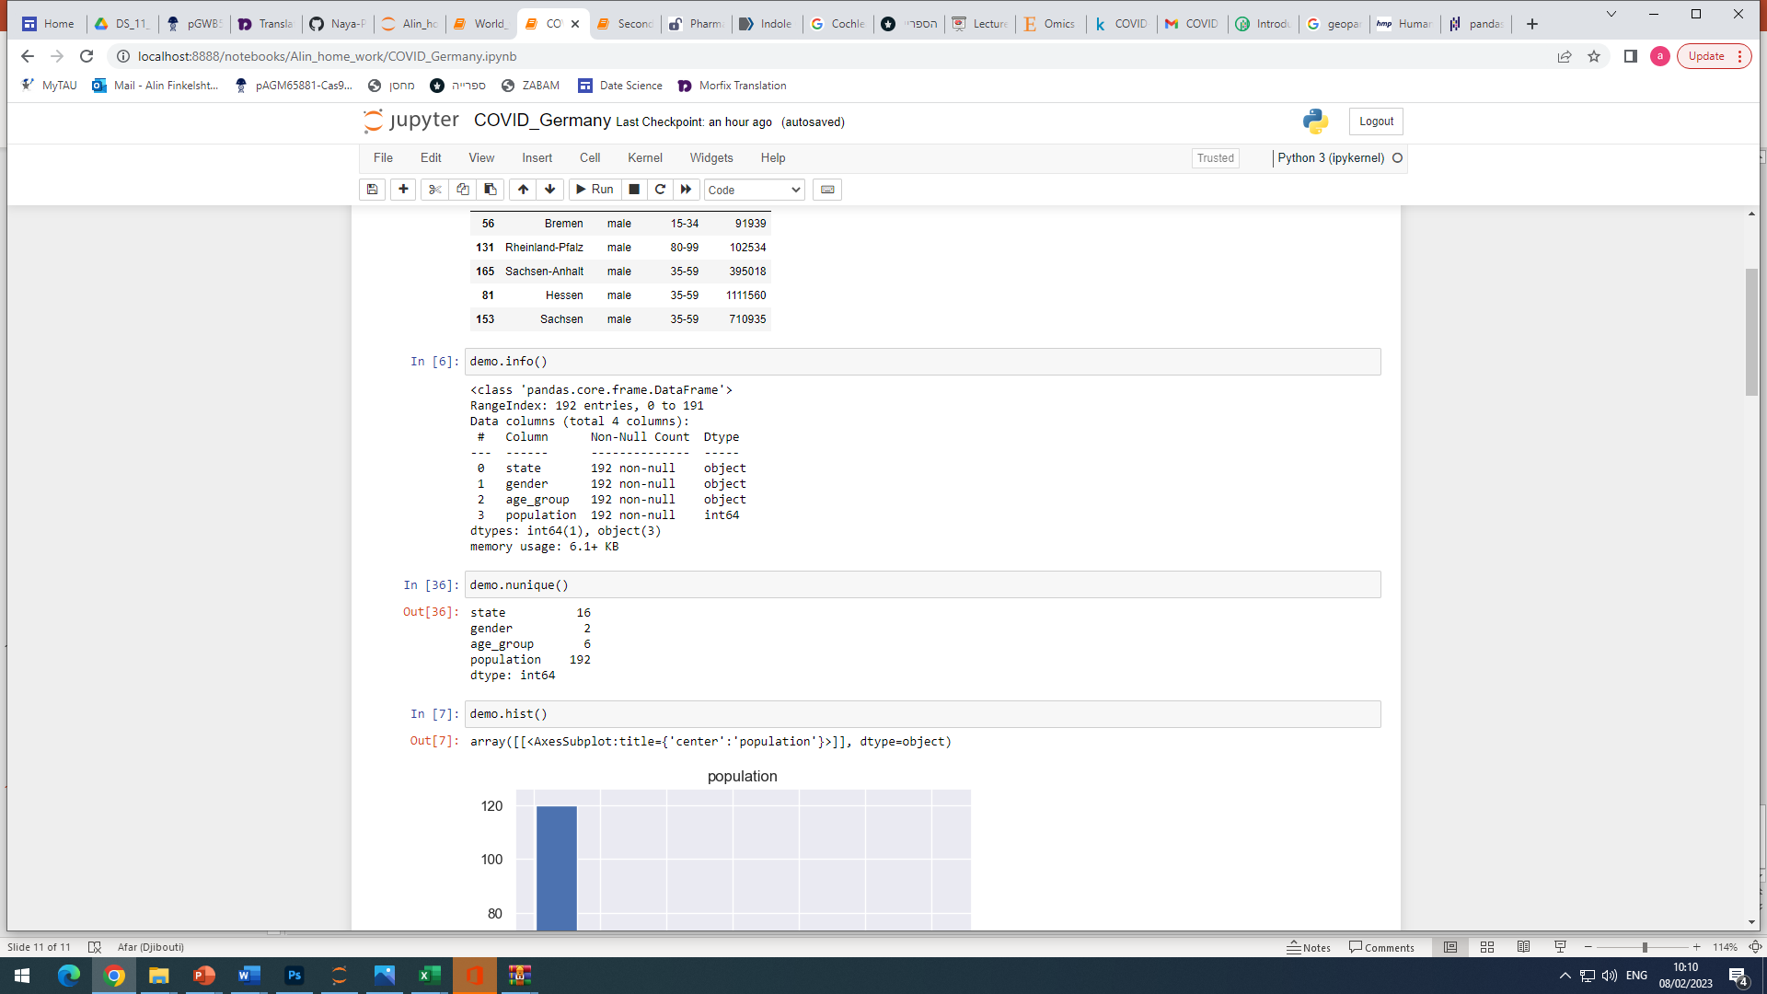
demographics_de.csv
Nunique
…………….

Slide 6
Visualizations Proposals

Slide 7
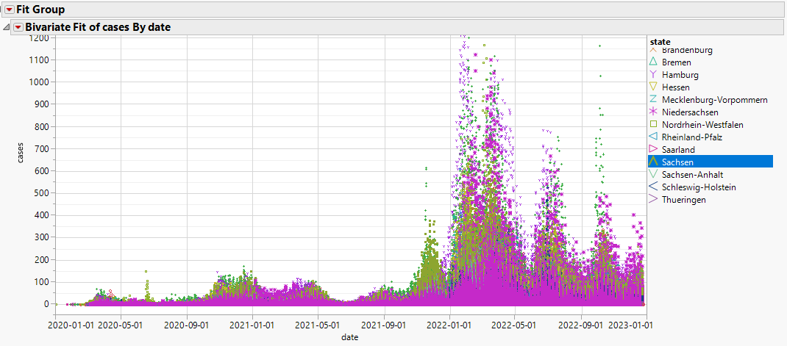
Cases time trend blocked by state
Done. Need to fix graph to line and show recovered and cases on same graph

Slide 8
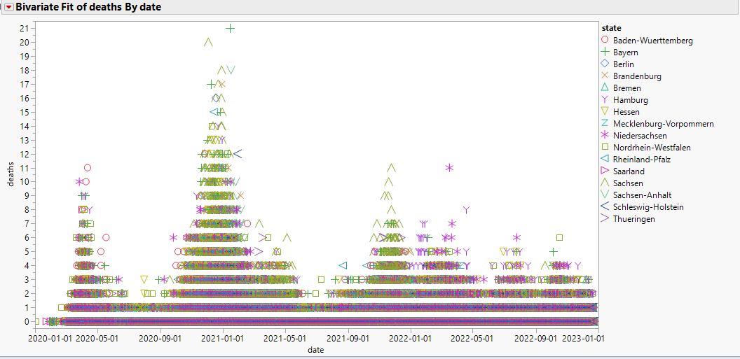
Deaths trends
Done

Slide 9
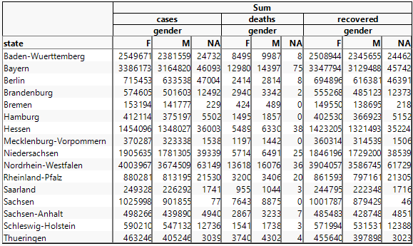
Summaries
Done

Slide 10
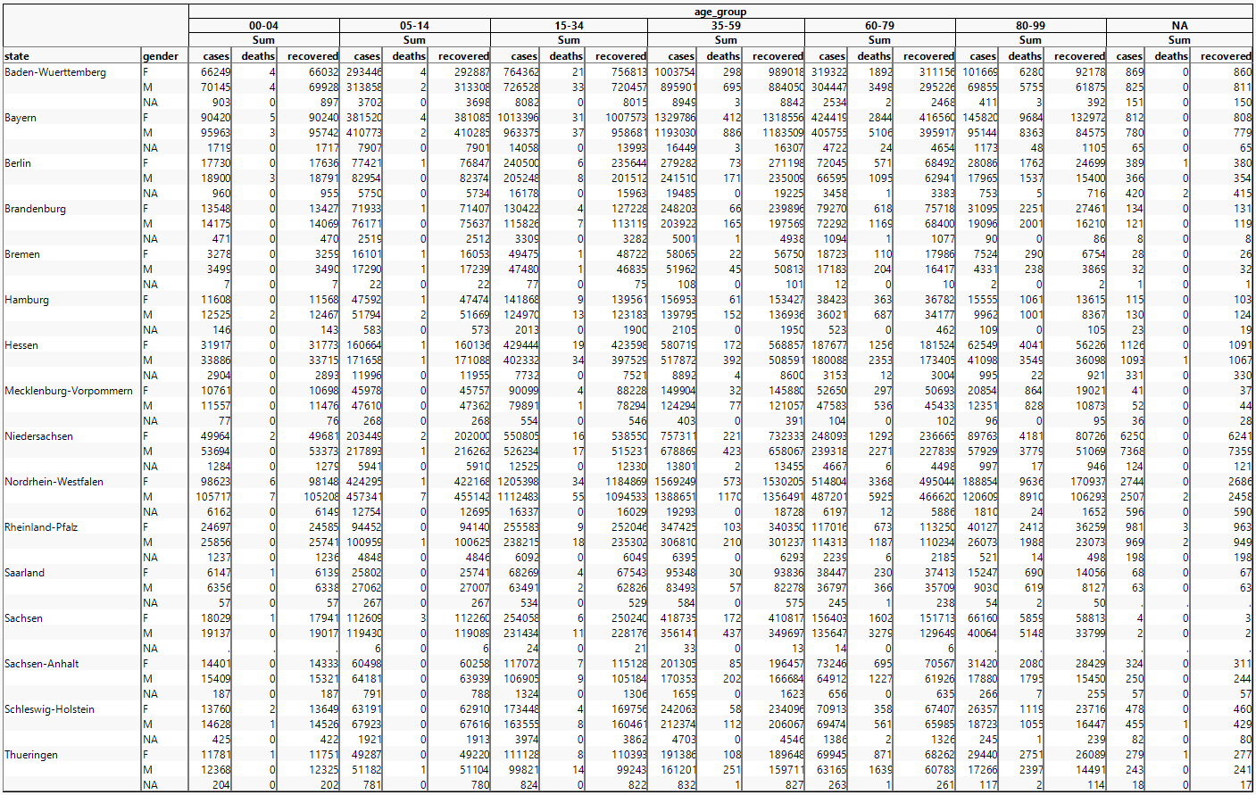
Done

Slide 11
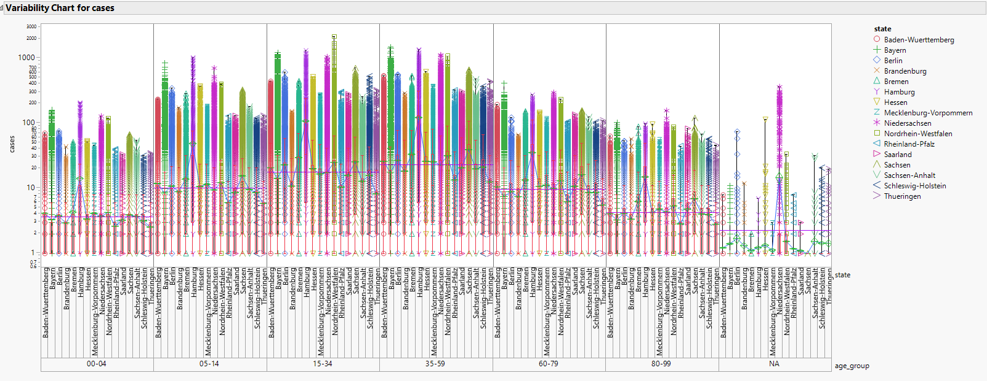
Is specific age group more vulnerable for infection
Alin

Slide 12
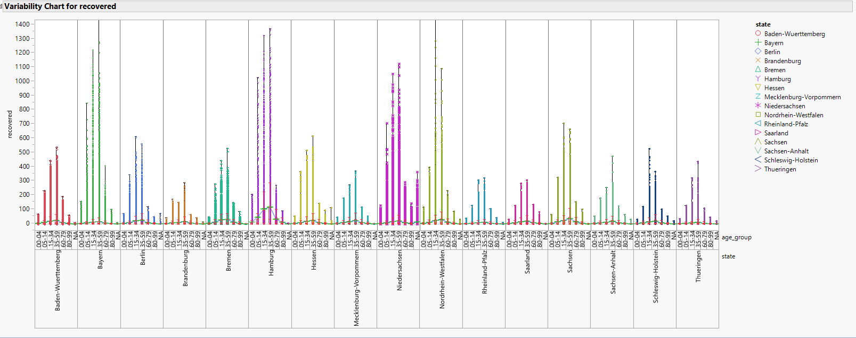
Is age can be predictor for recovery success?

Slide 13
Vaccination analysis in Germany

Slide 14
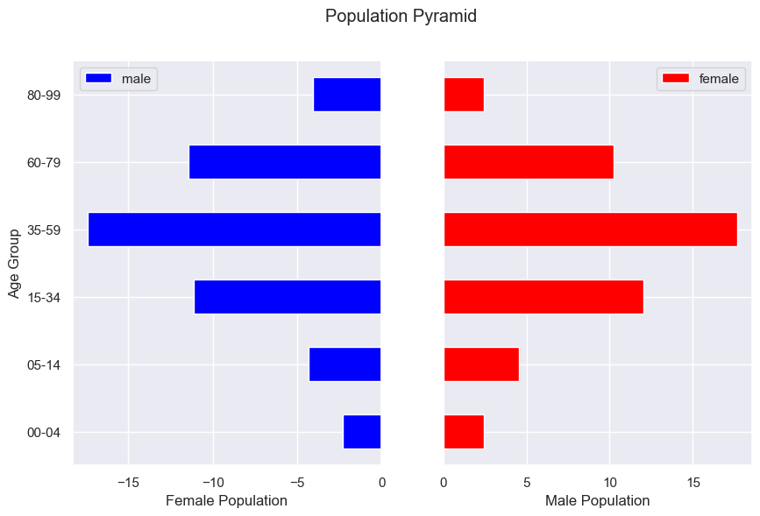
Population pyramid in Germany
Total population = 83019213

Slide 15
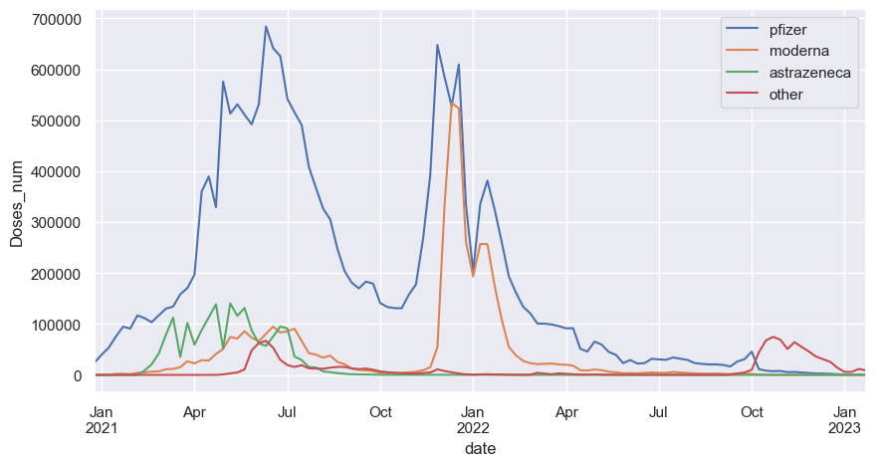
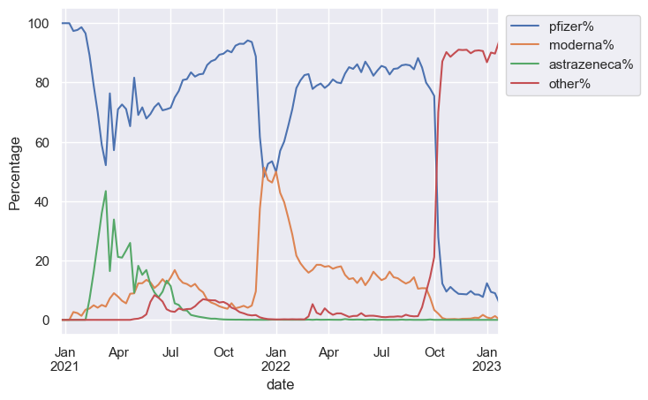
What is the contribution of each manufacturer?
There are 3 main manufacturers in Germany: Pfizer, moderna and astrazeneca.
The most commonly used is Pfizer
In Jan 22 it was a reduction in pfizer use that was replaced by moderna.
Astrazeneca was mainly used in the beginning: Feb-Jul 21 and abandoned afterwards.
Other manufacturers are used from Oct 22

Slide 16
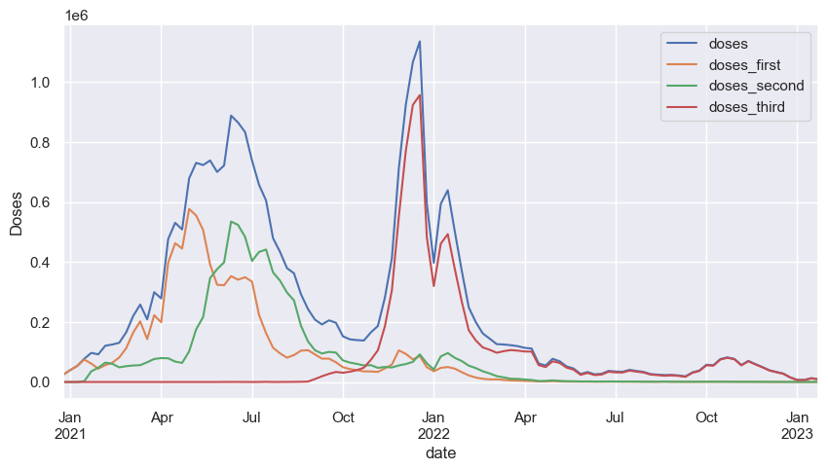
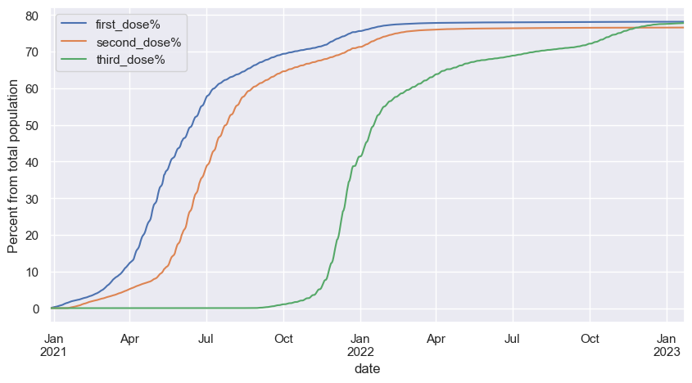
Vaccination patterns
With the appearance of the vaccines most of the population (~60%) got first and second dose.
Starting from Nov 2022 again most of the population (~60%) got the third dose.
Remaining population show a decrease ratios of vaccination, however, 78% are vaccinated with 3 doses today in Germany.
Conclusion – most population is very disciplined and obeys the government guidance.

Slide 17
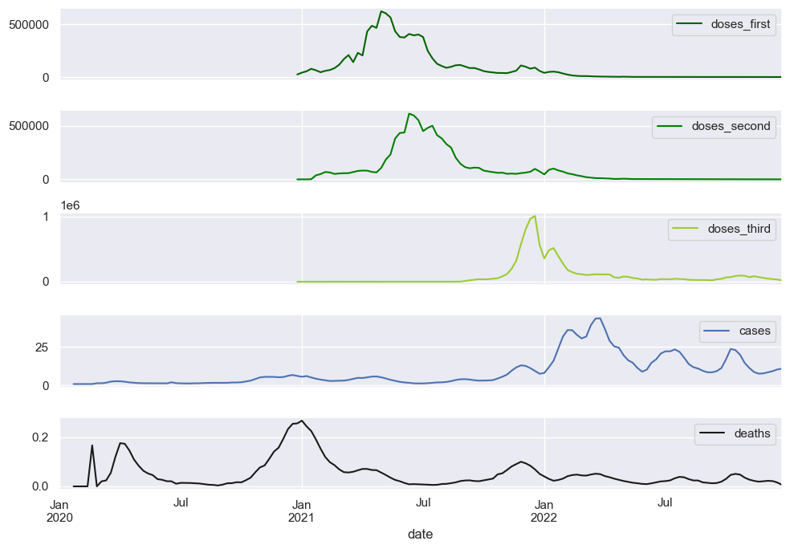
The effect of vaccination on number of cases and deaths
There is no effect on number of cases ) chance to get infected), but the number of deaths decreased following the vaccination.
The death ratio before 50% were vaccinated was 4.92% following 3 doses of vaccination it decreased to 0.16%!
4.92%
0.16%

Slide 18
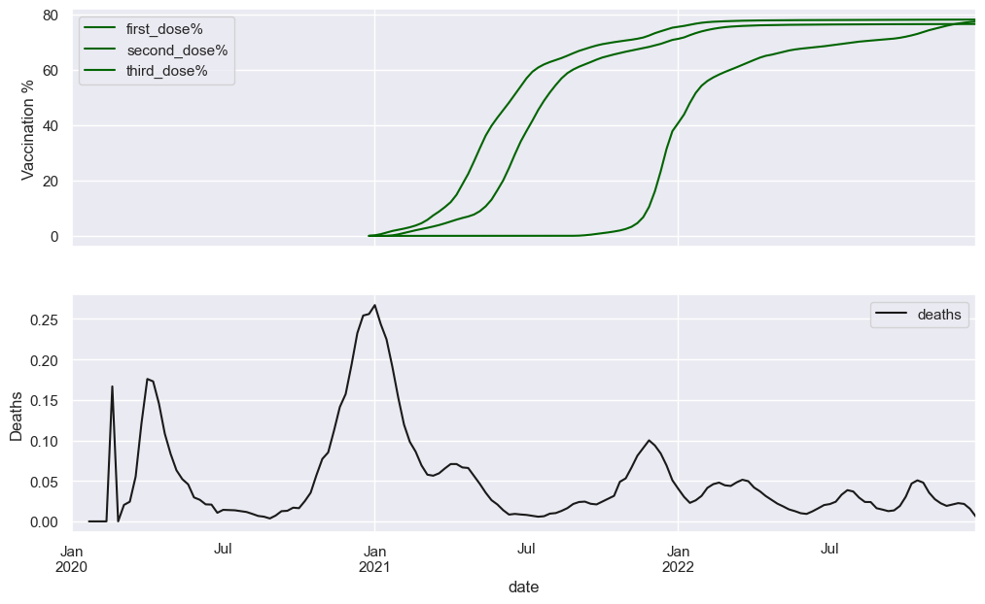
After first dose of vaccination the death rate decreased from 3.2% to 0.25%
2.5%
0.21%
60% vaccination

Slide 19
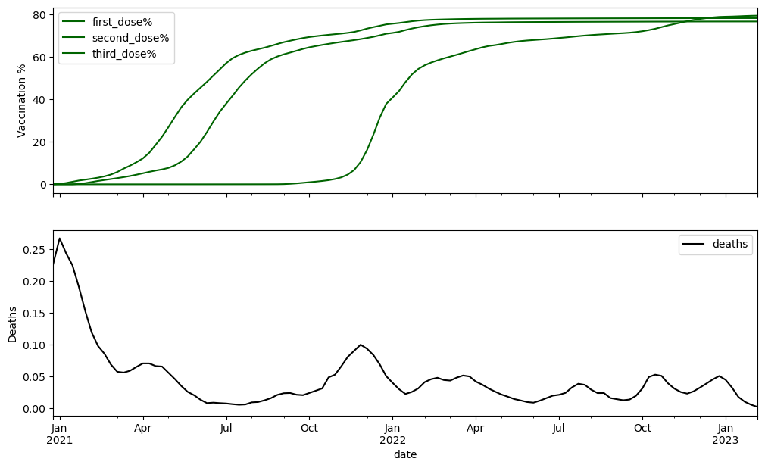
Death rate from the beginning of vaccination
0.6%
0.16%
60% vaccination

Slide 20
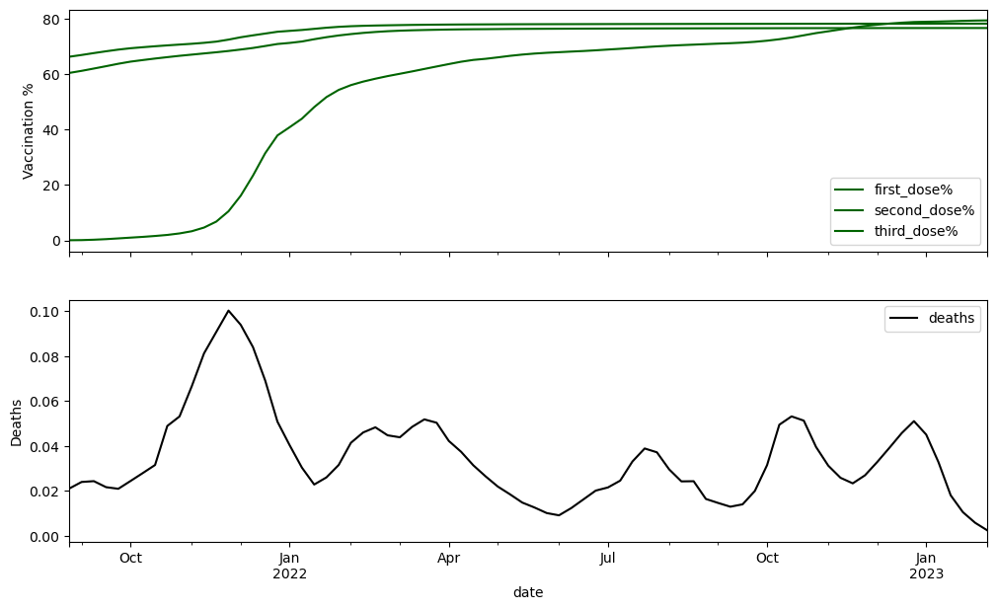
The 3rd dose of vaccination had beneficial effect on death rates even after two doses.
0.3%
0.16%
60% vaccination

Slide 21
The main questions we can ask
Are there differences between genders in getting sick, recovery ratio, death ratio - Felix
Vaccination trends – any conclusions – Alin done
Are there differences in different age groups ( same parameters as above) – Felix /Alin with pivot table and conclusions
Geopandas
Can we see differences in different regions of the country in the above parameters – Felix
6 graphs with cases/recovery numbers per state on maps (resample every 6 month) - Alin
% of population fully vaccinated/partially vaccinated/not vaccinated in each region/county Alin
Are regions with younger population tend to vaccinate more /less vs older population regions? Alin
Can we see a decrease in death following vaccination? – Alin - done

Slide 22
COVID-19 World Vaccination Progress
https://www.kaggle.com/datasets/gpreda/covid-world-vaccination-progress?select=country_vaccinations_by_manufacturer.csv

Slide 23
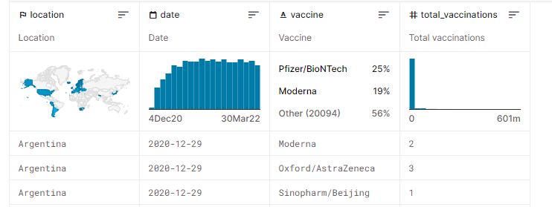
Basic information
The dataset contains 2 tables :
country_vaccinations_by_manufacturer.csv
 | Location | date | vaccines | Total vaccinations
ratio | worldwide | 4.12.20-30.3.22 | All manufacturer used in the country | Number of vaccinated per country
values | countries |  | Multiple categories
 | obj |  | obj | numerical

Slide 24
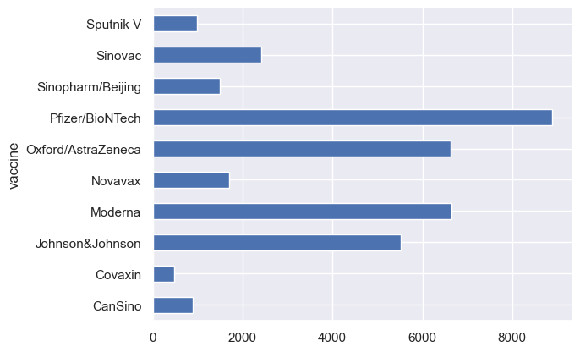
Number of vaccines/ manufacturer

Slide 25
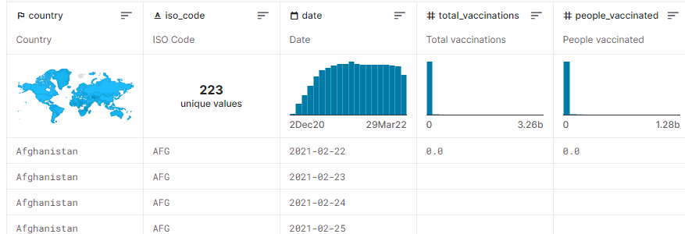
country_vaccinations.csv
Country- this is the country for which the vaccination information is provided;
Country ISO Code - ISO code for the country;
Date - date for the data entry; for some of the dates we have only the daily vaccinations, for others, only the (cumulative) total;
Total number of vaccinations - this is the absolute number of total immunizations in the country;
Total number of people vaccinated - a person, depending on the immunization scheme, will receive one or more (typically 2) vaccines; at a certain moment, the number of vaccination might be larger than the number of people;
Total number of people fully vaccinated - this is the number of people that received the entire set of immunization according to the immunization scheme (typically 2); at a certain moment in time, there might be a certain number of people that received one vaccine and another number (smaller) of people that received all vaccines in the scheme;
Daily vaccinations (raw) - for a certain data entry, the number of vaccination for that date/country;
Daily vaccinations - for a certain data entry, the number of vaccination for that date/country;
Total vaccinations per hundred - ratio (in percent) between vaccination number and total population up to the date in the country;
Total number of people vaccinated per hundred - ratio (in percent) between population immunized and total population up to the date in the country;
Total number of people fully vaccinated per hundred - ratio (in percent) between population fully immunized and total population up to the date in the country;
Number of vaccinations per day - number of daily vaccination for that day and country;
Daily vaccinations per million - ratio (in ppm) between vaccination number and total population for the current date in the country;
Vaccines used in the country - total number of vaccines used in the country (up to date);
Source name - source of the information (national authority, international organization, local organization etc.);
Source website - website of the source of information;

Slide 26
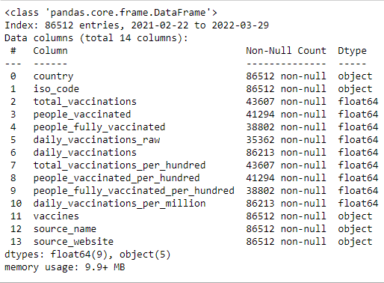
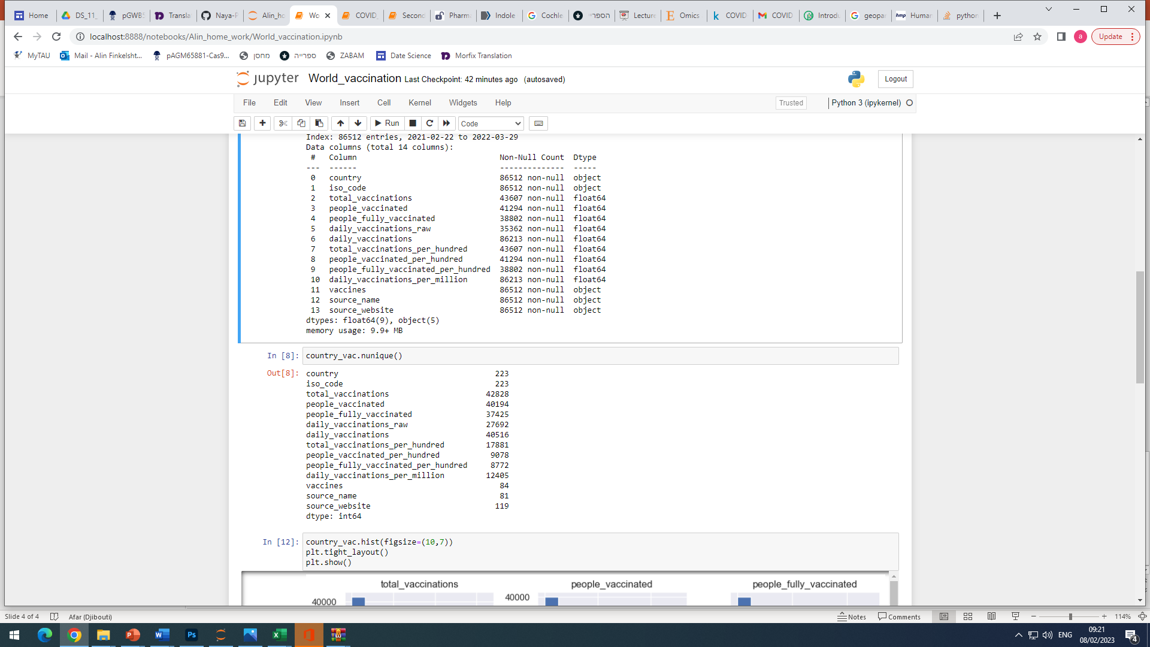
country_vaccinations.csv
Columns:
Nunique
…………….

Slide 27
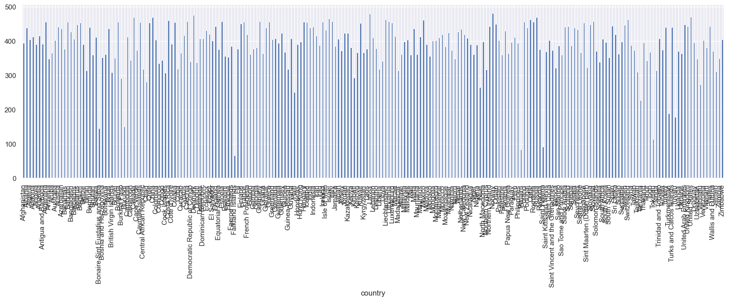
Total vaccinations/country

Slide 28
The main questions we can ask
% of population vaccinated in each country(visualization with GeoPandas)
% fully vaccinated vs partially vaccinated vs non vaccinated in each country
What is the main manufacturer in each country
What was the vaccination pattern(quick response in the beginning/slow long response/late response e.c.t)
Spread of each manufacturer in the world map(visualization with GeoPandas)
Group by regions like Europe, Middle east, Far east e.c.t. Is there a similar pattern of vaccination process in the region?

